Slide 1

NeuroDOT 2.2.0 Base
Appendix - Preprocessing Pipeline Analysis

Slide 2
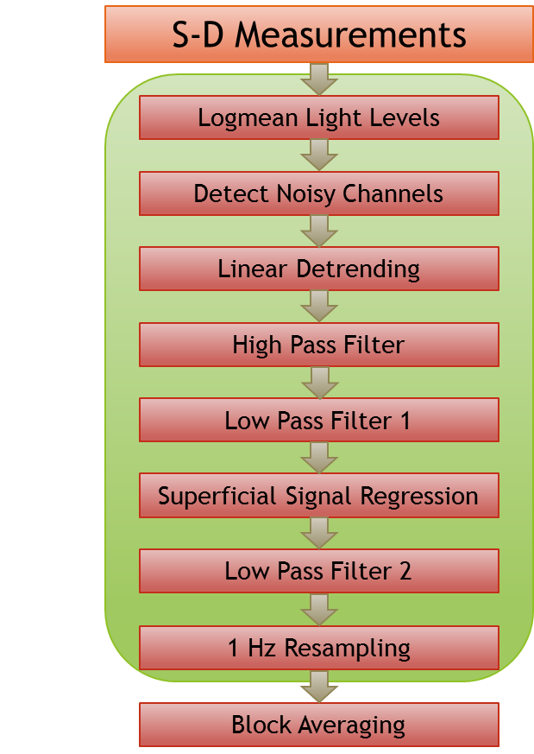
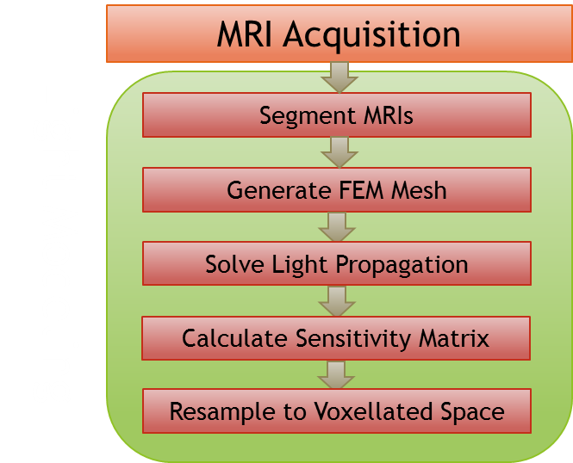
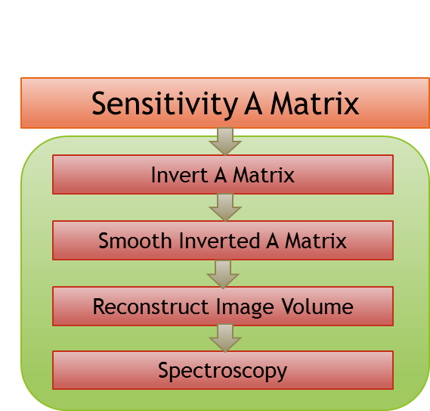
NeuroDOT 2 Overview Flowchart

Slide 3
Preprocessing Pipeline Flowchart
S-D Measurements
Logmean Light Levels
Detect Noisy Channels
Linear Detrending
High Pass Filter
Low Pass Filter 1
Superficial Signal Regression
Low Pass Filter 2
1 Hz Resampling
Block Averaging

Slide 4
Introduction
This is intended to be a short appendix for those who have completed the main preprocessing pipeline tutorial and are familiar with the functions presented therein.
The focus here will be on what effects we see on the end result (block average step) signal when various steps are taken out of the pipeline.
As before, all code in blue can be copied into MATLAB’s command line for execution.

Slide 5
Preprocessing Pipeline Flowchart
S-D Measurements
Logmean Light Levels
Detect Noisy Channels
Linear Detrending
High Pass Filter
Low Pass Filter 1
Superficial Signal Regression
Low Pass Filter 2
1 Hz Resampling
Block Averaging

Slide 6
A Quick Note on Logmean
The logmean step is essential to the preprocessing step. Without it, no intelligible signal can be extracted through the rest of the process.
1. Load the sample data and calculate its logmean: load('NeuroDOT_Base_HW_Sample_1.mat') lmdata = logmean(data);

Slide 7
A Quick Note on Logmean
2. Let’s also create a base set of results against which to compare the results from taking out any given step: info = FindGoodMeas(lmdata, info, 0.075); ddata = detrend_tts(lmdata); hpdata = highpass(ddata, 0.02, info.system.framerate); lp1data = lowpass(hpdata, 1, info.system.framerate); hem = gethem(lp1data, info); [SSRdata, ~] = regcorr(lp1data, info, hem); lp2data = lowpass(SSRdata, 0.5, info.system.framerate); [rdata, info1] = resample_tts(lp2data, info, 1, 1e-5); badata = BlockAverage(rdata, info1);

Slide 8
Preprocessing Pipeline Flowchart
S-D Measurements
Logmean Light Levels
Detect Noisy Channels
Linear Detrending
High Pass Filter
Low Pass Filter 1
Superficial Signal Regression
Low Pass Filter 2
1 Hz Resampling
Block Averaging

Slide 9
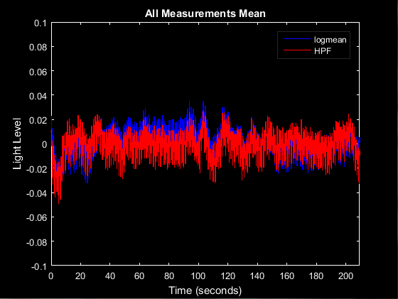
Removing the High Pass Filter
The HPF is intended to remove long-term drift from the signal. This is most evident from the mean time trace plots. Plot mean time traces of the base logmean and HPF: params.Nnns = [27, 33]; params.Nwls = 2; params.fig_handle = figure('Color', 'k'); PlotTimeTraceMean(lmdata, info, params) PlotTimeTraceMean(hpdata, info, params) legend({'logmean', 'HPF'}, 'Color', 'k', 'TextColor', 'w');

Slide 10
Removing the High Pass Filter
We can see clearly that the raw logmean data (top) has much greater long-term drift than the HPF data. How does this affect the final results? Run the rest of the pipeline, skipping HPF: HPFlp1data = lowpass(ddata, 1, info.system.framerate); HPFhem = gethem(HPFlp1data, info); [HPFSSRdata, ~] = regcorr(HPFlp1data, info, HPFhem); HPFlp2data = lowpass(HPFSSRdata, 0.5, info.system.framerate); [HPFrdata, info1] = resample_tts(HPFlp2data, info, 1, 1e-5); HPFbadata = BlockAverage(HPFrdata, info1);

Slide 11
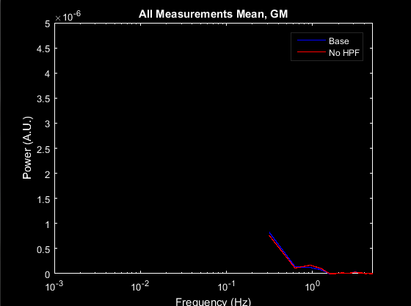
Removing the High Pass Filter
2. Plot the mean PS of each result: params.ylimits = [0, 5e-6]; params.fig_handle = figure('Color', 'k'); PlotPowerSpectrumMean(badata, info, params) PlotPowerSpectrumMean(HPFbadata, info, params) legend({'Base', 'No HPF'}, 'Color', 'k', 'TextColor', 'w'); params.ylimits = [];
As we see on the plots, the No HPF results have been corrupted by low frequency signals and likely also aliasing.

Slide 12
Removing the High Pass Filter
Be sure to clear variables from your workspace if you need to (though it may be wise to save block average results): clear HPFhem HPFlp1data HPFlp2data HPFSSRdata HPFrdata

Slide 13
Preprocessing Pipeline Flowchart
S-D Measurements
Logmean Light Levels
Detect Noisy Channels
Linear Detrending
High Pass Filter
Low Pass Filter 1
Superficial Signal Regression
Low Pass Filter 2
1 Hz Resampling
Block Averaging

Slide 14
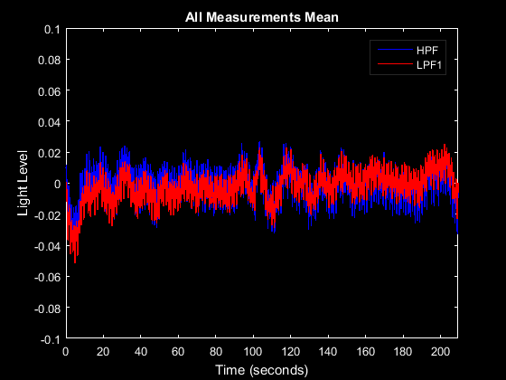
Removing Low Pass Filter 1
LPF1 is intended to account for later resampling (not done in this pipeline). This is most evident from the mean time trace plots.
Plot mean time traces of base HPF and LPF1: params.fig_handle = figure('Color', 'k'); PlotTimeTraceMean(hpdata, info, params) PlotTimeTraceMean(lp1data, info, params) legend({'HPF', 'LPF1'}, 'Color', 'k', 'TextColor', 'w');

Slide 15
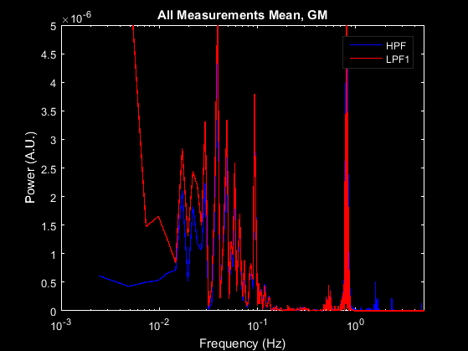
Removing Low Pass Filter 1
Let’s also review the power spectra of this stage.
Plot mean PS of base HPF and LPF1: params.ylimits = [0, 5e-6]; params.fig_handle = figure('Color', 'k'); PlotPowerSpectrumMean(hpdata, info, params) PlotPowerSpectrumMean(lp1data, info, params) params.ylimits = []; legend({'HPF', 'LPF1'}, 'Color', 'k', 'TextColor', 'w');

Slide 16
Removing Low Pass Filter 1
The mean time traces demonstrate quite nicely how LPF1 removes high-frequency signals, which could potentially lead to aliasing errors in resampling. Let’s compare the effect on results. Run the rest of the pipeline, skipping LPF1: LPF1hem = gethem(hpdata, info); [LPF1SSRdata, ~] = regcorr(hpdata, info, LPF1hem); LPF1lp2data = lowpass(LPF1SSRdata, 0.5, info.system.framerate); [LPF1rdata, info1] = resample_tts(LPF1lp2data, 1, 1e-5); LPF1badata = BlockAverage(LPF1rdata, info1);

Slide 17
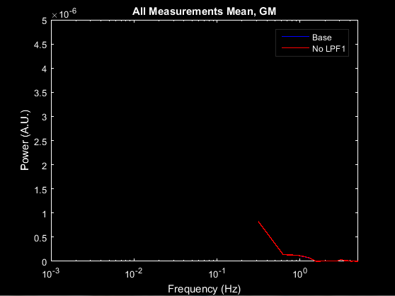
Removing Low Pass Filter 1
2. Plot the mean PS of each result: params.ylimits = [0, 5e-6]; params.fig_handle = figure('Color', 'k'); PlotPowerSpectrumMean(badata, info, params) PlotPowerSpectrumMean(LPF1badata, info, params) params.ylimits = []; legend({'Base', 'No LPF1'}, 'Color', 'k', 'TextColor', 'w');
The differences appear to be relatively subtle between the base (bluw) and sans-LPF1 results (red).

Slide 18
Preprocessing Pipeline Flowchart
S-D Measurements
Logmean Light Levels
Detect Noisy Channels
Linear Detrending
High Pass Filter
Low Pass Filter 1
Superficial Signal Regression
Low Pass Filter 2
1 Hz Resampling
Block Averaging

Slide 19
Removing Superficial Signal Regression
The SSR step reduces interference in the BOLD signal from blood vessels in the scalp.
Plot mean time traces of base LPF1 and SSR for NN1&2: params.rlimits = [10, 16; 27, 33]; params.fig_handle = figure('Color', 'k'); PlotTimeTraceMean(lp1data, info, params) PlotTimeTraceMean(SSRdata, info, params) params.rlimits = [27, 33]; legend({'LPF1, r \in [10, 16]', 'LPF1, r \in [27, 33]', 'SSR, r \in [10, 16]', 'SSR, r \in [27, 33]'}, 'Color', 'k', 'TextColor', 'w');

Slide 20
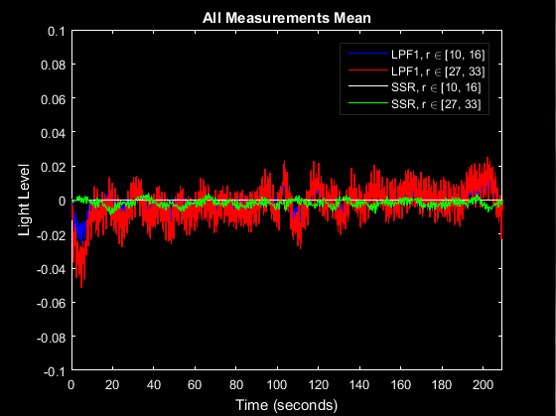
Removing Superficial Signal Regression
As we see, superficial measurements (blue) have been almost completely filtered out from LPF1 (blue + red) after SSR (white and green), while cortical measurements (red and green) still have a significant signal left. Let’s see what happens to the results when we take SSR out. Let's run the rest of the pipeline from LPF1, ignoring SSR: SSRlp2data = lowpass(lp1data, 0.5, info.system.framerate); [SSRrdata, info1] = resample_tts(SSRlp2data, info, 1, 1e-5); SSRbadata = BlockAverage(SSRrdata, info1);

Slide 21
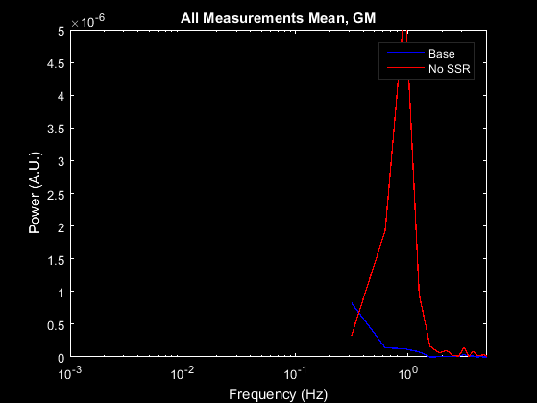
Removing Superficial Signal Regression
Plot the power spectra of each result: params.ylimits = [0, 5e-6]; params.fig_handle = figure('Color', 'k'); PlotPowerSpectrumMean(badata, info, params) PlotPowerSpectrumMean(SSRbadata, info, params) params.ylimits = []; legend({'Base', 'No SSR'}, 'Color', 'k', 'TextColor', 'w');
The hemodynamic signal that we saw filtered out of the mean time traces is quite visible in the sans-SSR data (red).

Slide 22
Preprocessing Pipeline Flowchart
S-D Measurements
Logmean Light Levels
Detect Noisy Channels
Linear Detrending
High Pass Filter
Low Pass Filter 1
Superficial Signal Regression
Low Pass Filter 2
1 Hz Resampling
Block Averaging

Slide 23
A Final Word
The contribution of LPF2 is relatively small, and thus was not included here.
Block averaging, of course, like logmean is integral to evaluating the results, and thus cannot be removed.

Slide 24
That’s It (Again)
Congratulations! You have finished the NeuroDOT 2 Base Preprocessing Pipeline Analysis Appendix.
For further questions or more information, please consult the NeuroDOT 2 Base User Manual and the various Appendices.
NeuroDOT 2 Team:
Adam Eggebrecht (aeggebre@wustl.edu)
David Muccigrosso (muccigrosso.david@wustl.edu)

